Slide 1


MENTAL ILLNESS @ WORK
What is the impact?
Are Companies Prepared to face it?
Are we as colleagues?

Slide 2
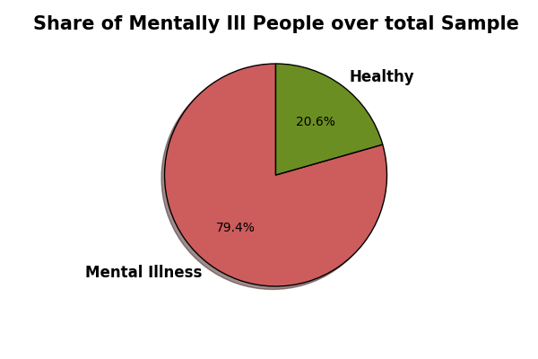
THE SAMPLE
Over almost 1250 employees interviewed from companies all over the world, almost 80% of the respondent reported some degree of mental illness.

Slide 3
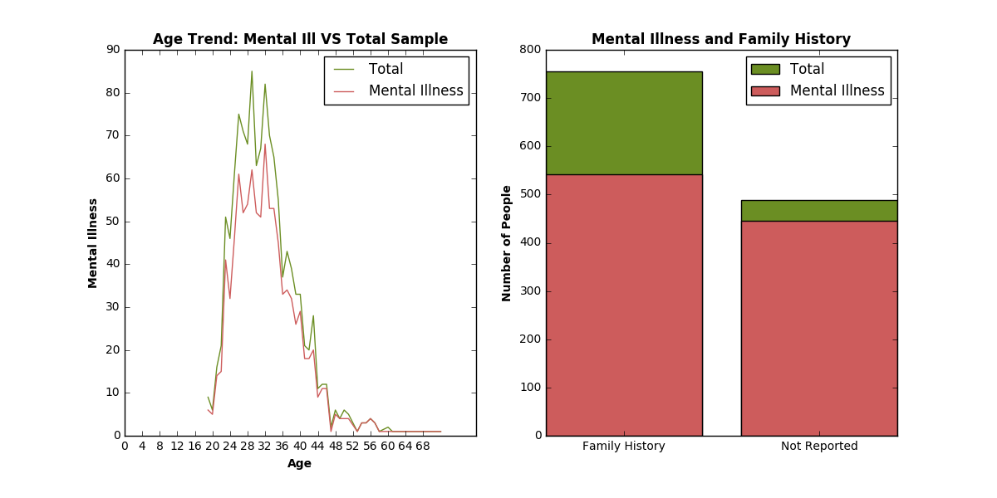
DO AGE and FAMILY HISTORY PLAY A ROLE?
The average Age for both the Total sample and the portion affected by Mental Illness is 32 years.
Contrary to what expected, relative share of people reporting Mental Illness is higher when no previous cases in the Family are reported: 72% against 91%

Slide 4
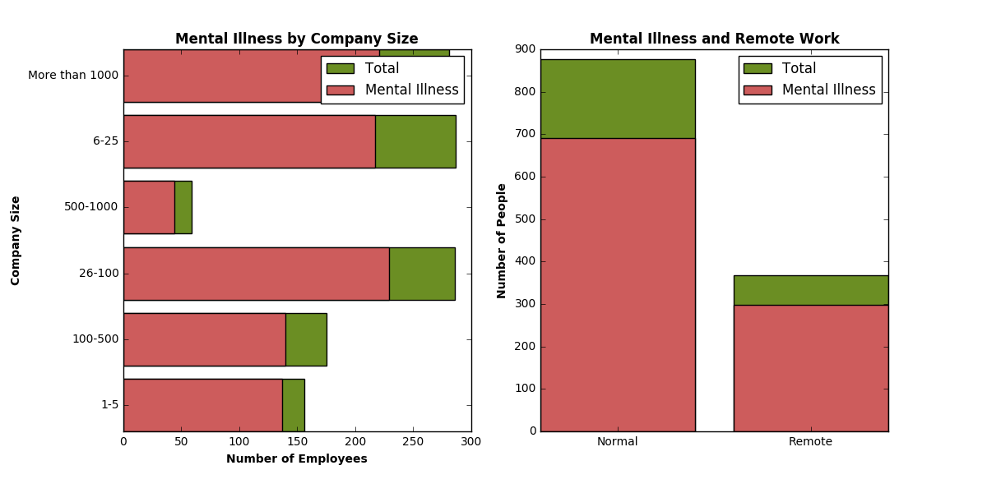
COMPANY SIZE AND REMOTE WORK
In relative terms, Mental Illness is more frequent among small (26-100 and 100-500 employees) and very small companeies (1-5 employees): 80%, 80% and 87% respectively
The ratio of employees reporting Metntal health issues is almost equal for Normal and Remote jobs: 78% against 81%

Slide 5
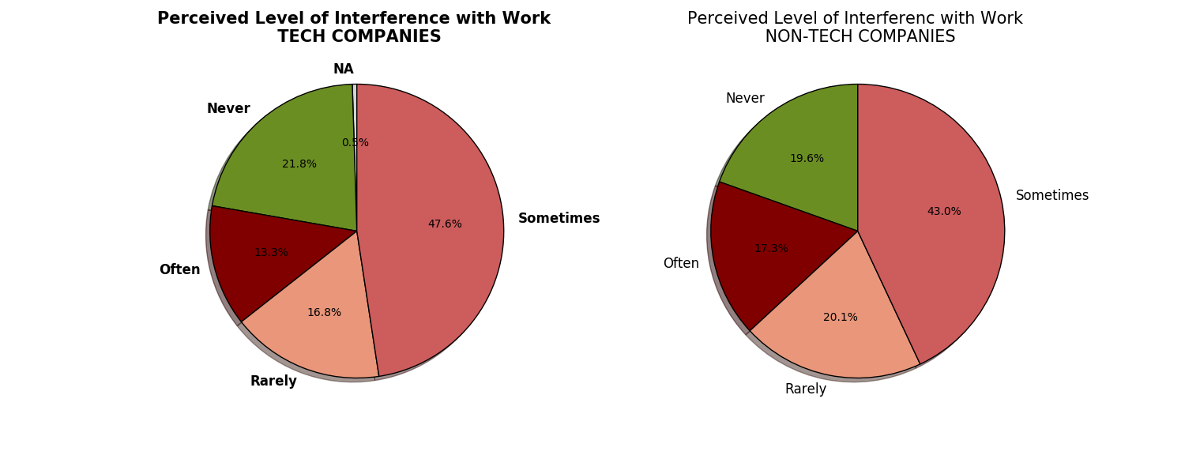
INTERFERENCE WITH WORK – TECH VS NON-TECH COMPANIES
Tech companies appeat to be a slightly better work place for employees with Mental Health issues that may interfere with their activity
When existing, the extent of the level of interferenece in Tech companies seems less polarized towards the extremes (Often VS Rarely)

Slide 6
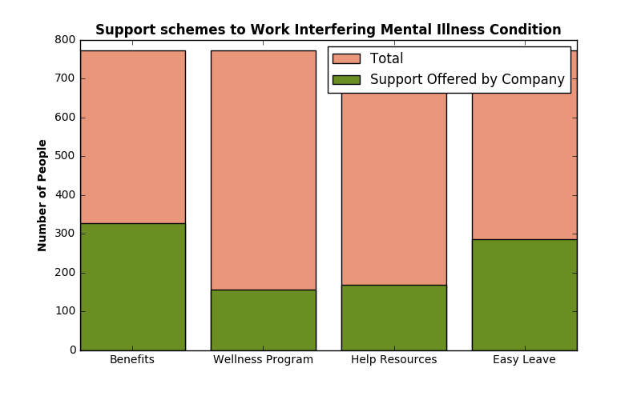
INTERFERENCE WITH WORK – ACTUAL NEEDS AND SUPPORT PROVIDED
In general, the level of support for Employees with invalidating Mental Illness condition is perceived as inadequate.
The most frequent level of support is represented by Mental Health Benefits schemes (42% of cases)
The less frequent is represented by deidcated Mental Health Wellness programs (only 20% of cases)
Leave for Mental Health issues is guaranteed only in 1/3 of the cases.

Slide 7
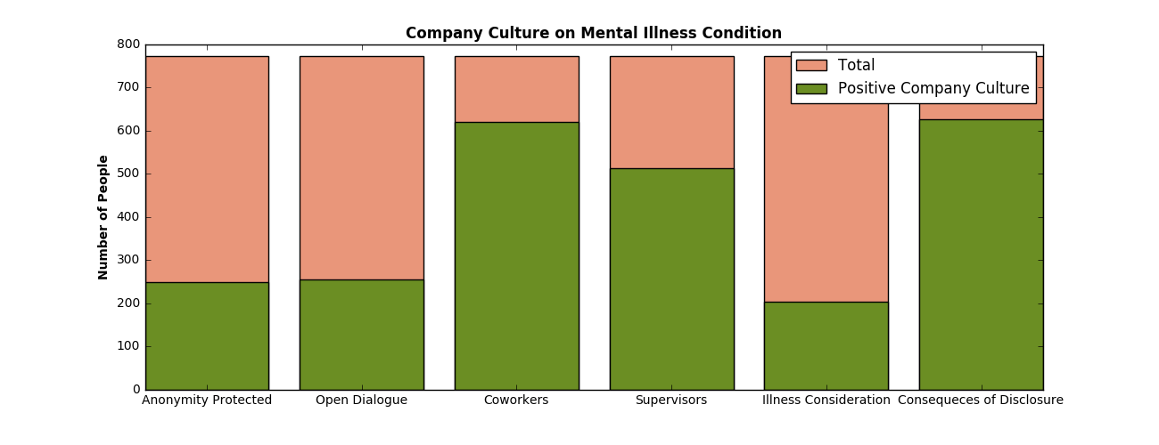
INTERFERENCE WITH WORK – COMPANY CULTURE AND WORK ENVIRONMENT
Companies Culture is not adequately supportive overall for workers with Mental Health issues: Anonimity when benefiting of support is rarely protected (32%) and Mental Illness condition is often disregarded as serious problem (only 26%)
However, there in most of the cases no negative consequences for disclosure are perceived and dialogue on the topic with Supervisors and Coworkers especially is perceived as supportve in the majority of the cases

